Slide 1

Project Title: "YouTube Data Harvesting Project” Using Python, YouTube Data API, MySQL, and Streamlit APP VISHAALI RJ 08/05/2024

Slide 2
PROJECT OVERVIEW
BRIEF OVERVIEW OF THE PROJECT:
The YouTube Data Harvesting Project aims to extract data from YouTube channels, transform it, and load it into a MySQL database for analysis and visualization.
PURPOSE AND OBJECTIVES:
The project aims to gather insights into channel performance, video metrics, and audience engagement on YouTube.
TOOLS AND TECHNOLOGIES USED:
Python for scripting
YouTube Data API for data extraction
MySQL for data storage
Streamlit for building the user interface

Slide 3

PROJECT COMPONENTS AND TOOLS & TECHNOLOGIES

Slide 4

PROJECT COMPONENTS
DATA TRANSFORMATION:
The process of retrieving data from YouTube using the YouTube Data API.
DATA EXTRACTION:
Converting and formatting extracted data into a suitable format for analysis.
DATA LOADING:
Storing transformed data into a MySQL database for future use.

Slide 5


TOOLS AND TECHNOLOGIES
PYTHON:
Used for scripting and data manipulation.
YOUTUBE DATA API:
Provides access to YouTube data, including channels, videos, and comments.
MYSQL:
Used to store structured data in a relational database.
STREAMLIT:
A Python library for building interactive web apps.

Slide 6


DATA EXTRACTION
DESCRIPTION OF THE DATA EXTRACTION PROCESS:
Use of the YouTube Data API to fetch channel details,
video information, and comments.
Example:
Retrieving channel metadata such as title,
description, view count, subscriber count, etc.

Slide 7

DATA TRANSFORMATION
DESCRIPTION OF THE DATA TRANSFORMATION PROCESS:
Converting extracted data into a consistent format suitable for analysis.
Examples:
Converting duration from ISO 8601 format to seconds.
Formatting dates into a readable format.

Slide 8

DATA LOADING
DESCRIPTION OF THE DATA LOADING PROCESS:
Storing transformed data into a MySQL database for future querying.
STEPS:
Connecting to MySQL database.
Creating tables for channel details, video details, and comments details.
Inserting data into respective tables.

Slide 9

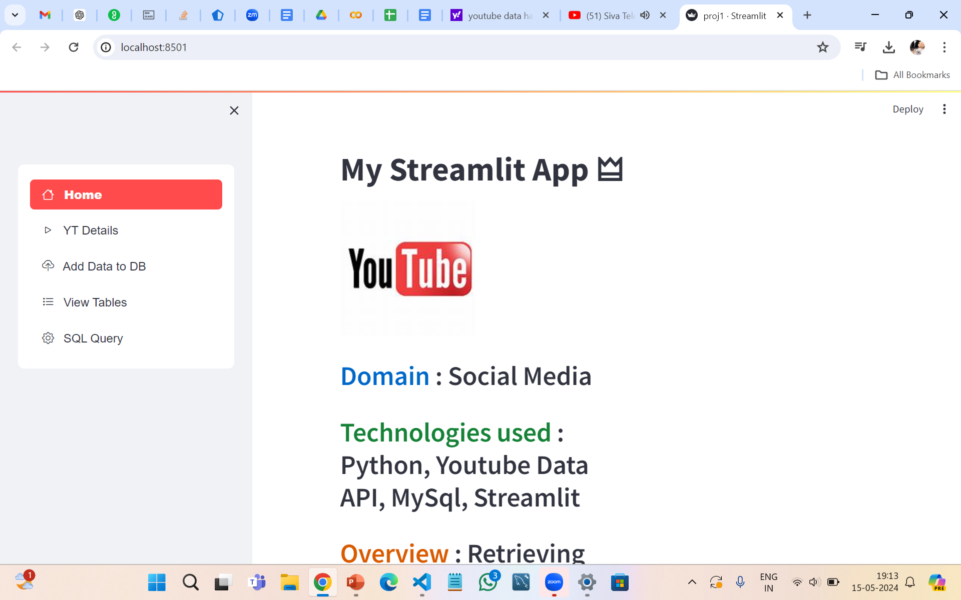
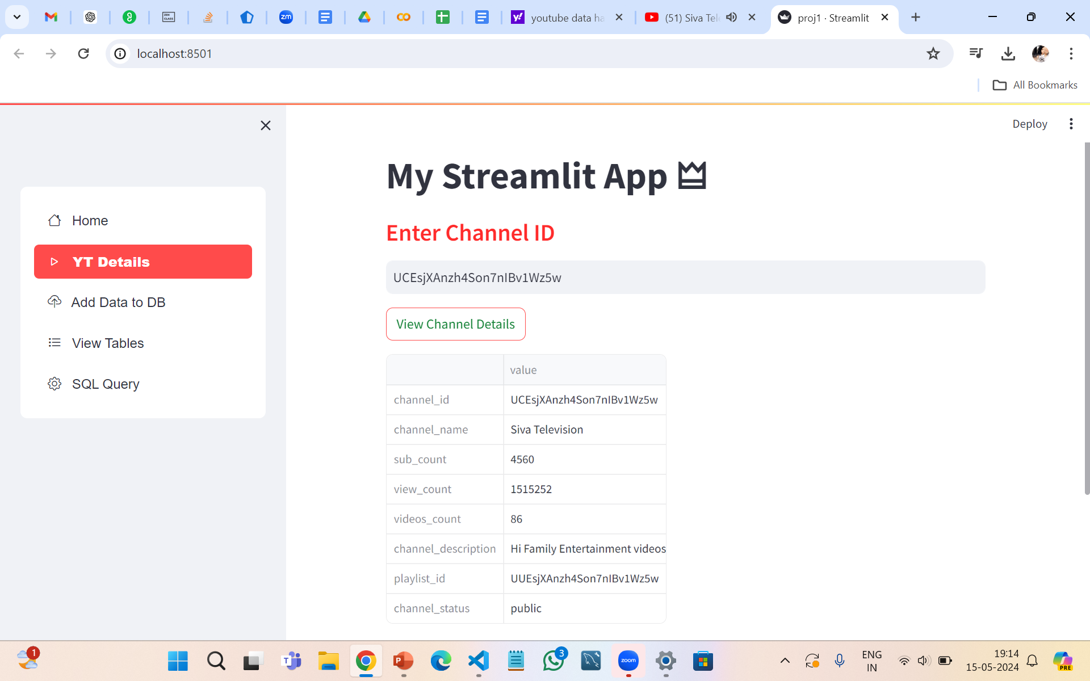
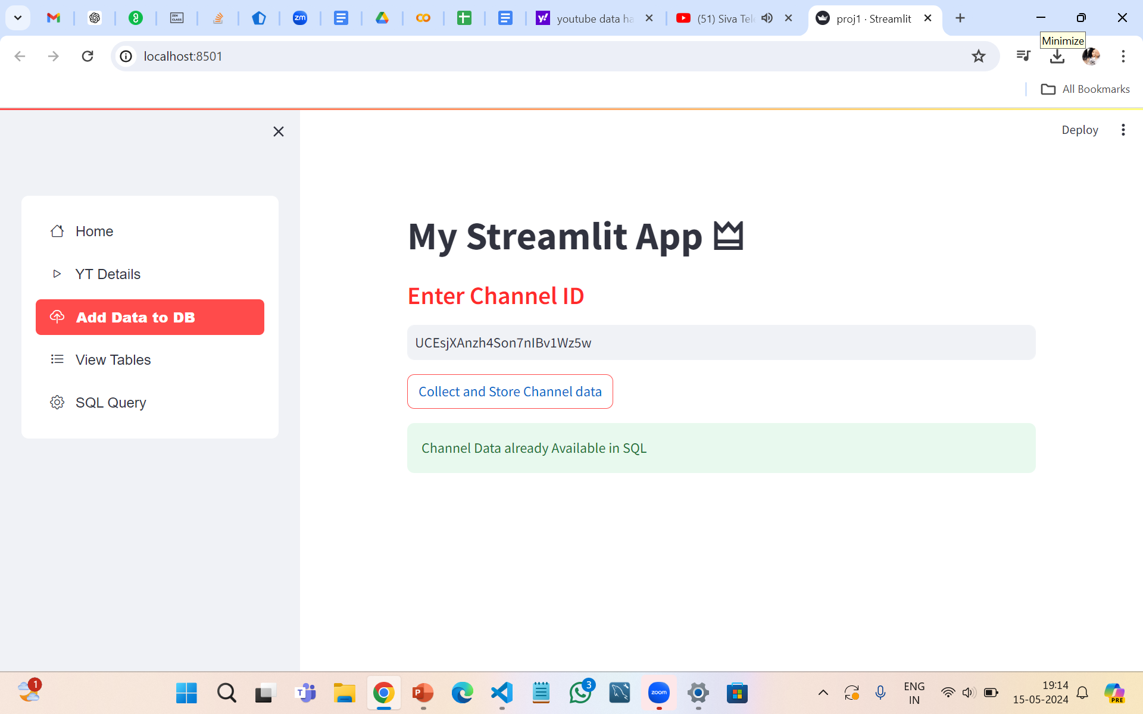
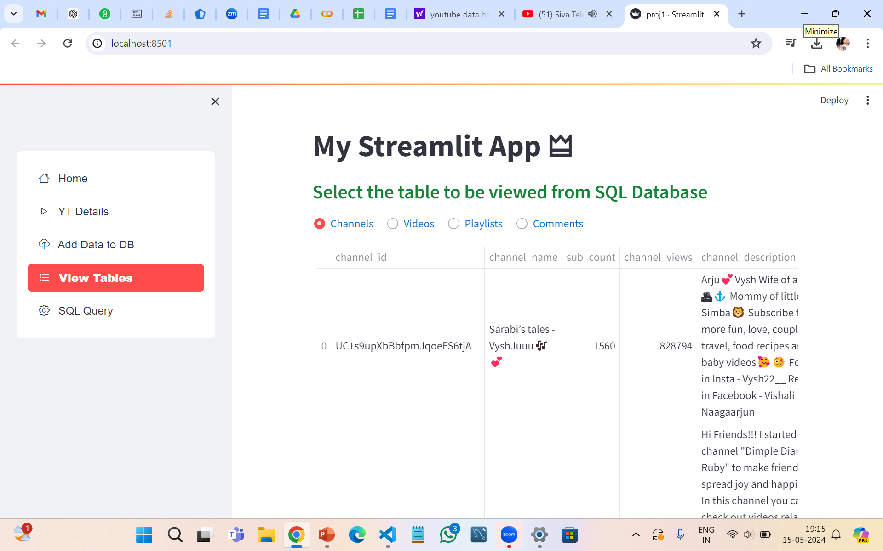
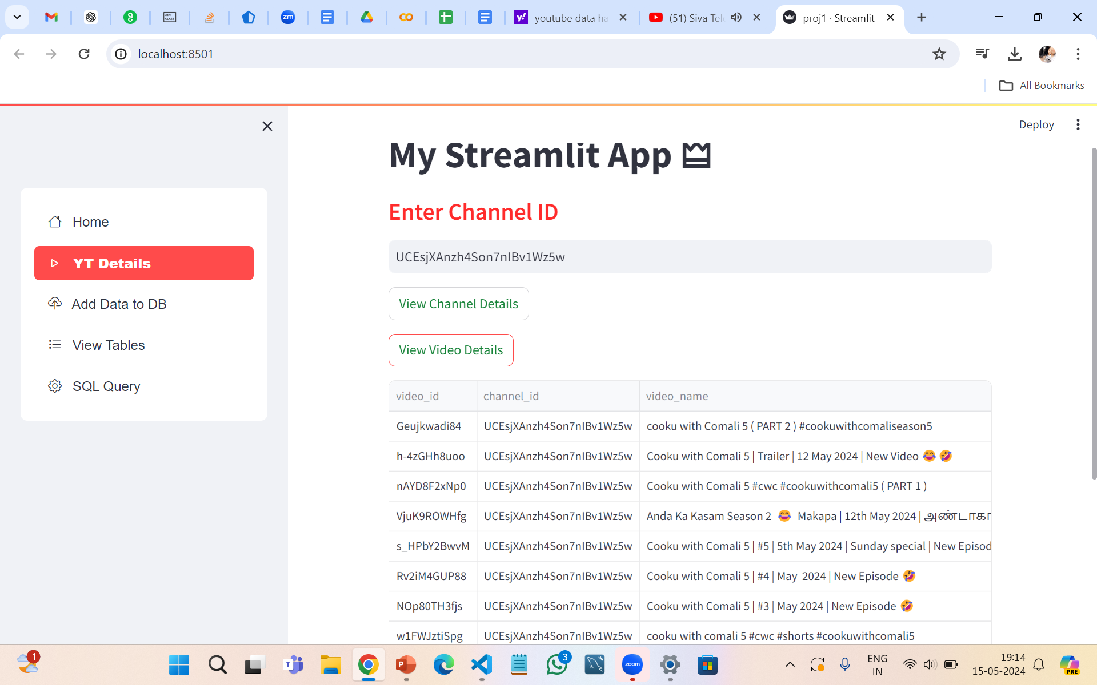
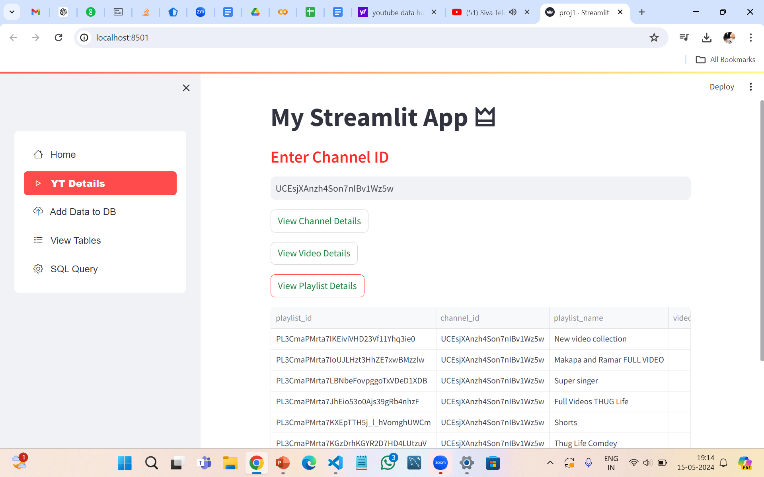
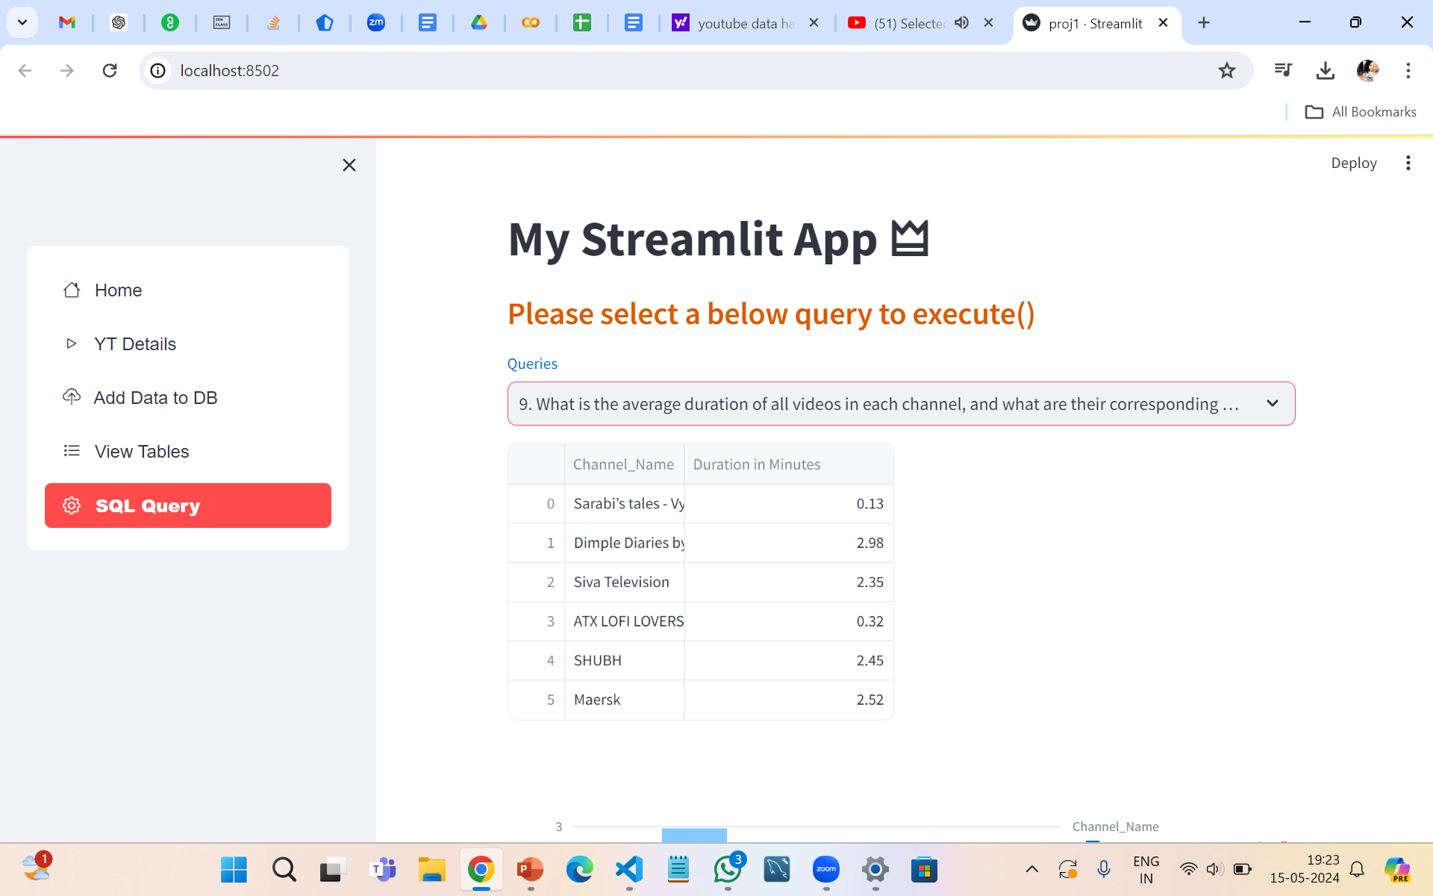
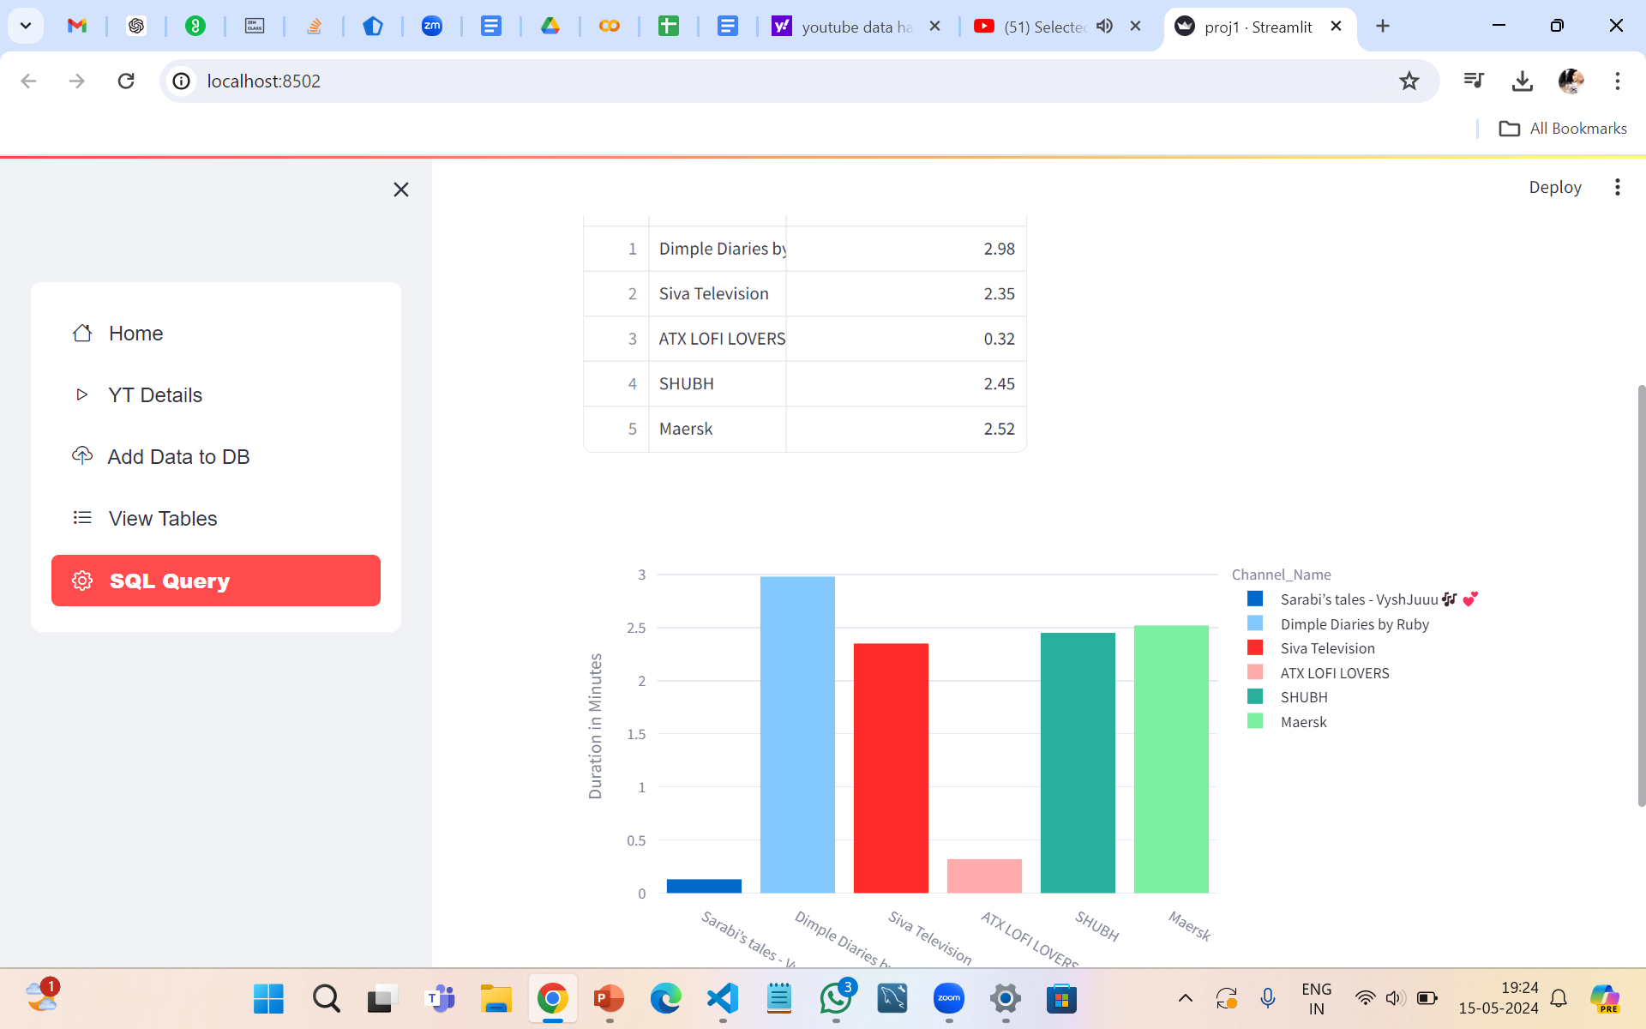
PROJECT DEMONSTRATION

Slide 10
CONCLUSION
The YouTube data harvesting project provided valuable insights into audience behavior, content performance, and channel growth strategies.
By leveraging data-driven decision-making, content creators can optimize their content strategies, improve audience engagement, and drive channel growth.
Continuous monitoring and analysis of key metrics will be essential for staying informed about audience preferences and evolving trends on the platform.
Overall, the project demonstrated the power of data analytics in informing content creation, marketing, and audience engagement strategies on YouTube.

Slide 11


Thank you

